Slide 1

Mini-Project
TITLE : Asset Management Company Dataset
Submitted by :
Sneha Sanjeevkumar (project no :2)

Slide 2
Problem Definition
Dataset:
Companies, rounds2
Problem Statement :
The Objective is to identify the best countries and a suitable investment type for making the investment. The overall strategy is to invest where others are investing, implying that the best countries are the ones ‘where most investors are investing’

Slide 3
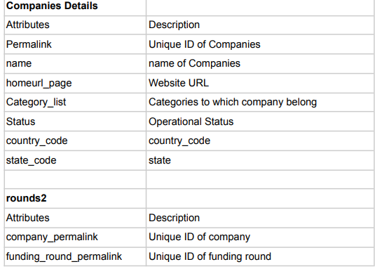
Data Set Description
DATA DICTIONARY:

Slide 4
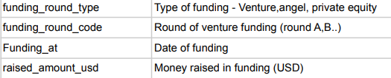
Data Set Description
DATA DICTIONARY:

Slide 5
Data Set Description
This is real investment data taken from crunchbase.com.
Company details: The data for different companies has been provided for investing in different sectors by taking reference from past investment strategies on several sectors in various countries. The company details include the unique company id’s their names, URL’s for their websites, the category to which these said companies belong, operational statuses, countries in which they operate and their codes.
Round2: gives us the funding rounds, its types which include seeds venture, private equity and many more and funding round codes, dates of fundings and money raised in USD per investment.

Slide 6
Business Importance of Problem
Investment Decision Making
Client servicing
Risk management
To identify the best sectors, countries, and a suitable investment type for making investments.
Goals of data analysis:
• Investment type analysis
Country Analysis
Sector Analysis

Slide 7
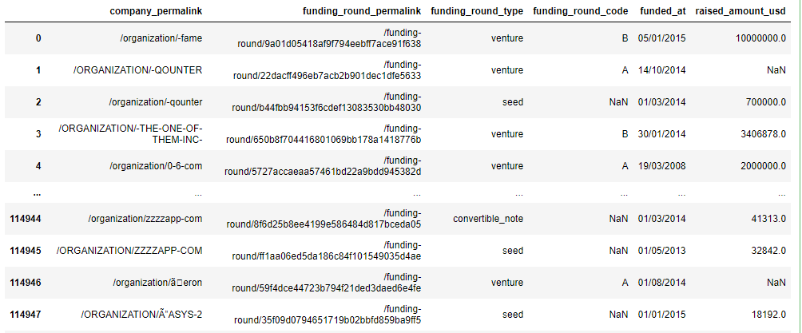
Project Flow – Question 1
Reading the Rounds2, companies.txt files.
Code –
Ouput -

Slide 8
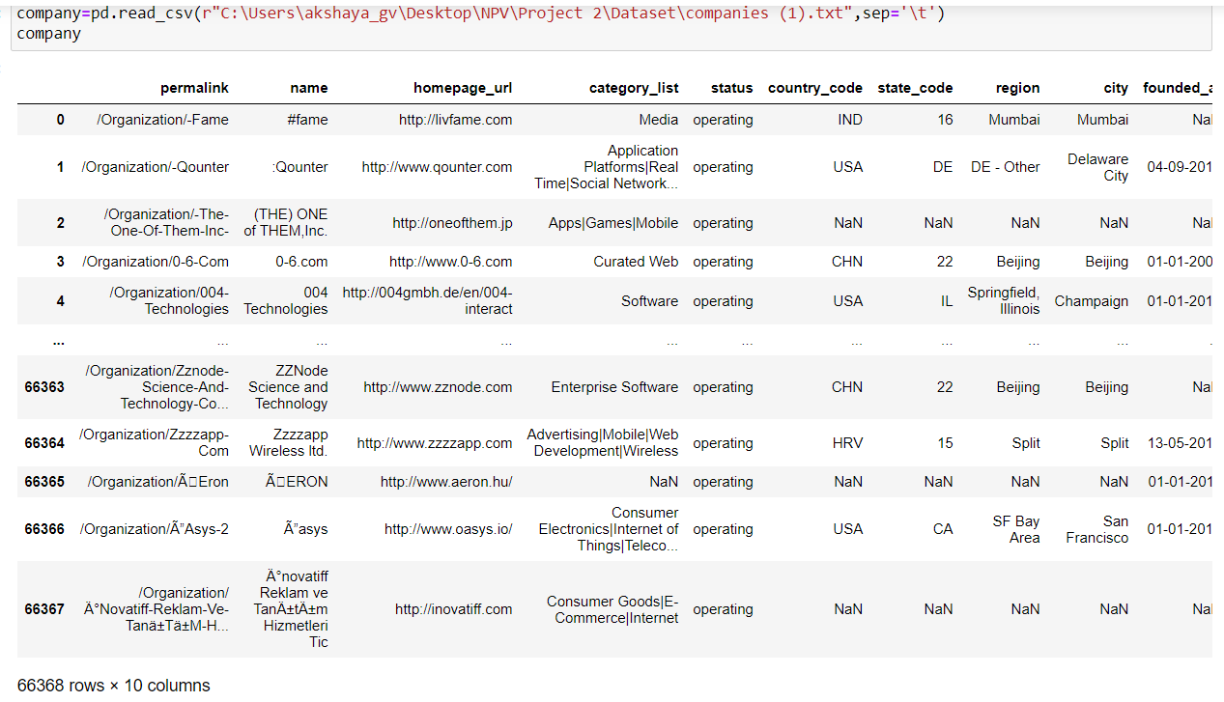
Project Flow – Question 1
Reading the Rounds2, companies.txt files.
Code –
Output -

Slide 9
Project Flow – Question 2
How many unique companies are present in rounds2?
.nunique() gives the count of unique of the companies in rounds2 dataset
Code –
Output -

Slide 10
Project Flow – Question 3
How many unique companies are present in the companies file?
.nunique() gives the count of unique of the companies in companies dataset
Code –
Output -

Slide 11
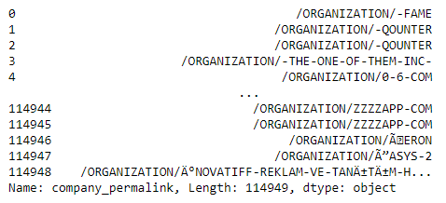
Project Flow – Question 4
Write the code to convert companies[‘permalink’] and Round2[‘company_permalink’] columns to uppercase
.str.upper() converts the strings in the series in uppercase.
Code –
Output -

Slide 12
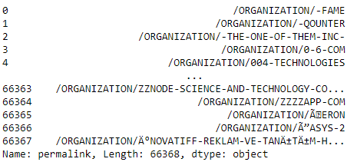
Project Flow – Question 4
Write the code to convert companies[‘permalink’] and Round2[‘company_permalink’] columns to uppercase
Code –
Output -

Slide 13
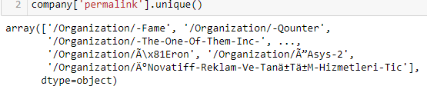
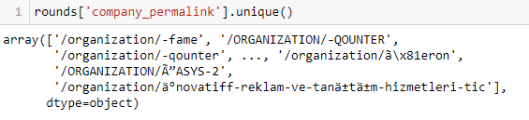
Project Flow – Question 5
Are there any companies in the rounds2 file which are not present in companies.txt ?
First we got the unique companies in each dataset and noticed that some of the strings in rounds datasets are in uppercase. So we converted both the series in uppercase and checked for companies in rounds2 dataset that not present in companies dataset by adding ‘~’ not operator.
Code –

Slide 14
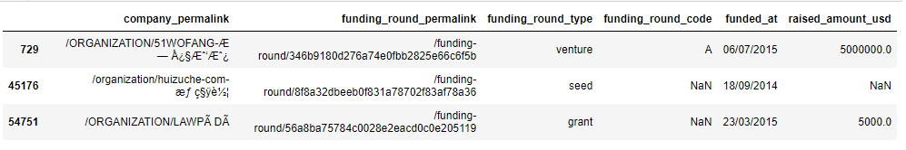
Project Flow – Question 5
Are there any companies in the rounds2 file which are not present in companies.txt ?
Code –
Output -

Slide 15
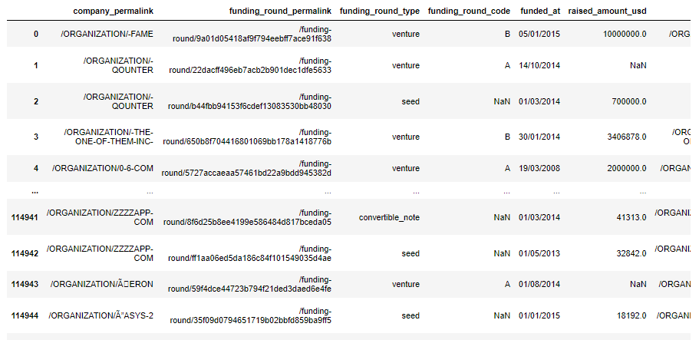
Project Flow – Question 6
Merge the two data frames so that all variables (columns) in the company's frame are added to the rounds2 data frame. Name the merged frame master_dataframe. How many observations are present in master_dataframe ?
master_dataframe is created by merging rounds and company data frame by the permalinks.
Code –
Output -

Slide 16
Project Flow – Question 6
Merge the two data frames so that all variables (columns) in the company's frame are added to the rounds2 data frame. Name the merged frame master_dataframe. How many observations are present in master_dataframe ?
len() gives the number of observations in the data frame.
Code –
Output -

Slide 17
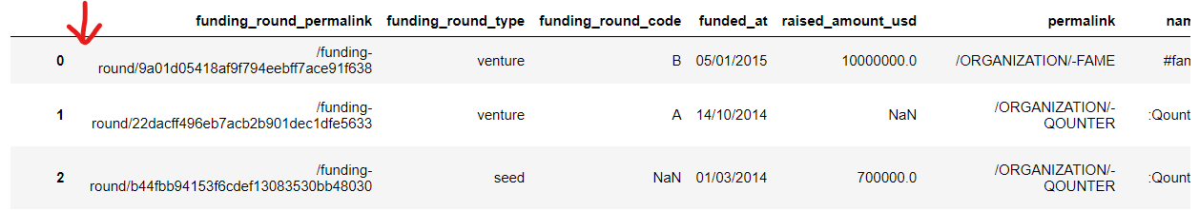
Project Flow – Question 7
Write the code to drop the redundant column ‘'company_permalink' from the master_dataframe.
.drop() allows to drop the company_permalink column in master_dataframe and inplace=True makes the change as permanent in the data frame.
Code –
Output – company_permalink is dropped from its position.

Slide 18
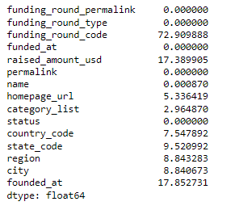
Project Flow – Question 8
Write the code to find the percentage missing value (column-wise) in master_dataframe. Drop unnecessary columns.
Total of null values for each column divided by total observations and multiplying the whole with 100 gives the null value percentages of each column.
Code –
Output -

Slide 19
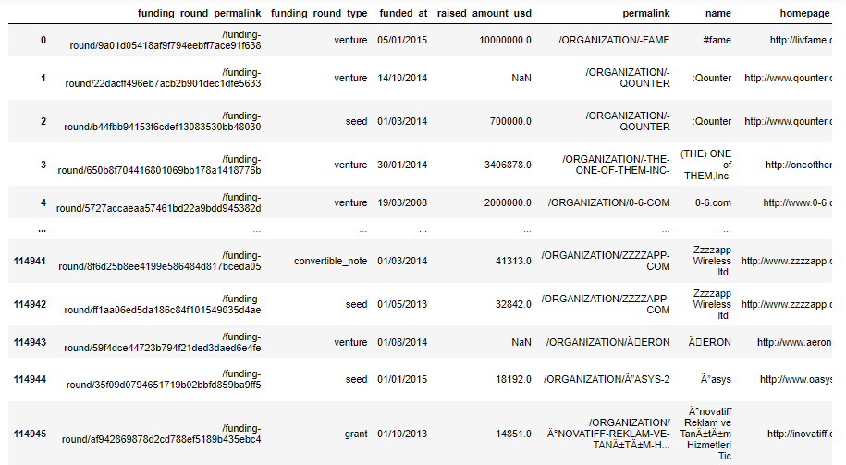
Project Flow – Question 8
Write the code to find the percentage missing value (column-wise) in master_dataframe. Drop unnecessary columns.
funding_round_code has null values more than 50% (72.90%) and it is dropped.
Code –
Output -

Slide 20
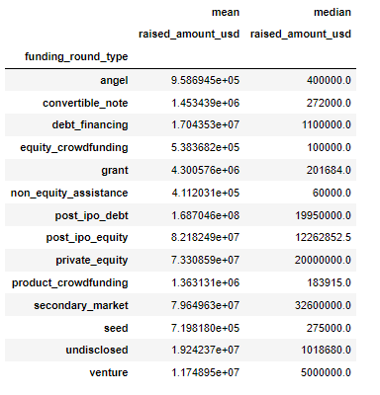
Project Flow – Question 9
Create a pivot table to compare the mean and median values for ‘raised_amount_usd’ and ‘funding_round_type’ across different funding round categories.
Using pivot table, mean and median of each funding_round_type can be displayed
Code –
Output -

Slide 21
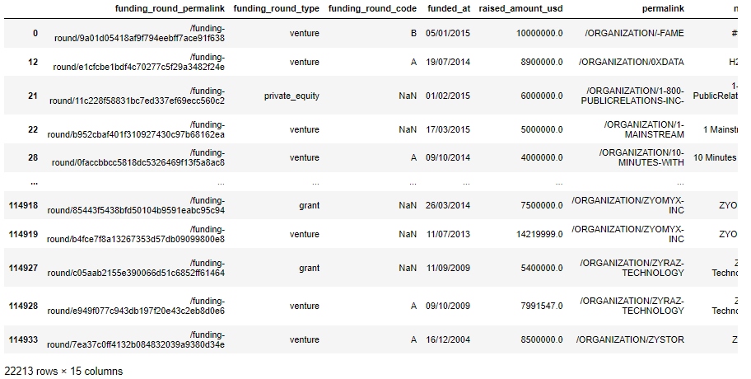
Project Flow – Question 10
Filter the master_dataframe on ‘raised_amount_usd’ such as ‘raised_amount_usd’ lie between 4 Millions to 15 Millions.
The master_dataframe is filtered based on both the conditions by ‘&’ operator
Code –
Output -

Slide 22
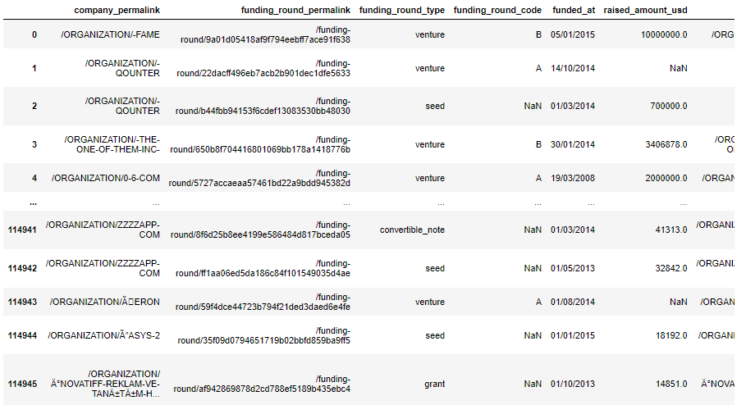
Project Flow – Question 11
Identify the top 9 countries in terms of highest investment in ‘venture’ fund type.
Code – New data frame was created by merging rounds and company data frames.
Output -

Slide 23
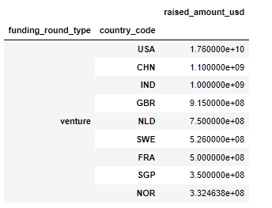
Project Flow – Question 11
Identify the top 9 countries in terms of highest investment in ‘venture’ fund type.
Code – Pivot table is used to the maximum amount based on each funding round type and each country. .sort_values() are used to obtain on venture’s top 9 countries.
Output -

Slide 24
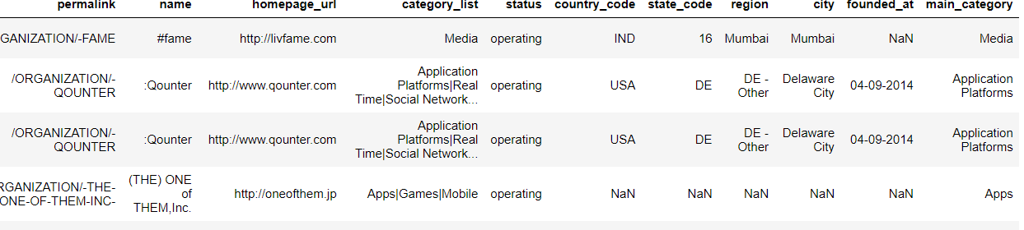
Project Flow – Question 12
Create the ‘main_category’ column by extracting the main sector using the column ‘category_list’. Hint - Use the Lambda function or string function.
Code – Main category should contain the first word before |. Lambda is used to apply split(‘|’) in all the observations of category_list.
Output -

Slide 25
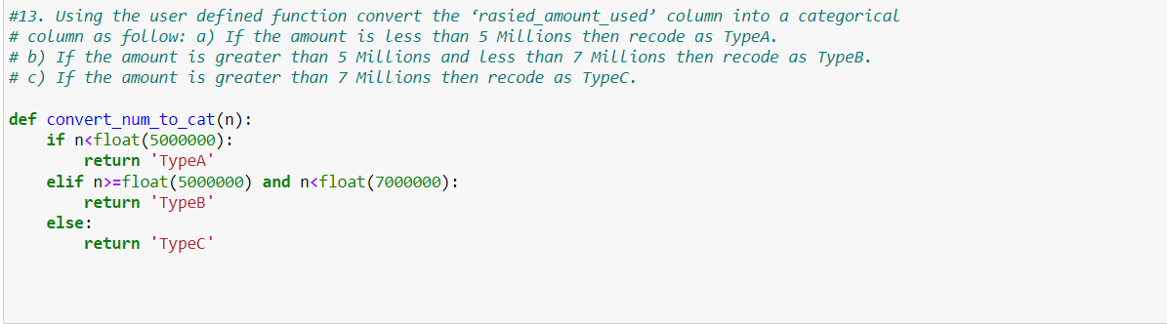
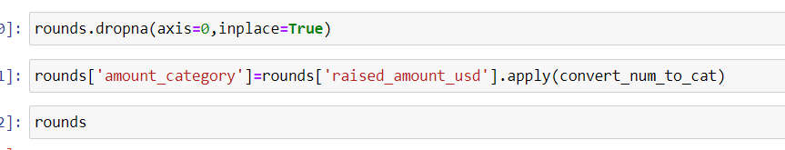
Project Flow – Question 13
Using the user defined function convert the ‘raised_amount_usd’ column into a categorical column as follow: a) If the amount is less than 5 Millions then recode as TypeA. b) If the amount is greater than 5 Millions and less than 7 Millions then recode as TypeB. c) If the amount is greater than 7 Millions then recode as TypeC.
Code – A user defined function was created including all the conditions. Rows with null values in raised_amount_usd are dropped to avoid the condition being applied to the null values. The user defined function is then applied to get new column ‘amount_category’.

Slide 26
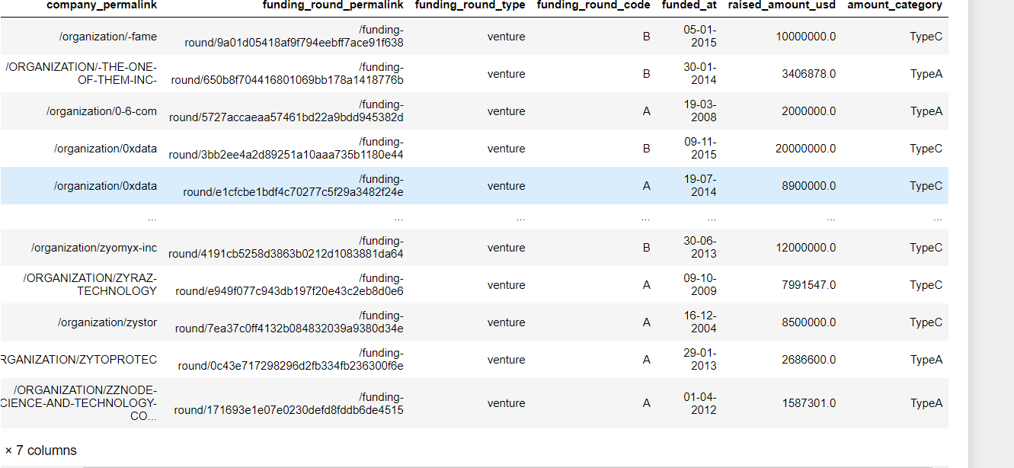
Project Flow – Question 13
Using the user defined function convert the ‘raised_amount_usd’ column into a categorical column as follow: a) If the amount is less than 5 Millions then recode as TypeA. b) If the amount is greater than 5 Millions and less than 7 Millions then recode as TypeB. c) If the amount is greater than 7 Millions then recode as TypeC.
Output -

Slide 27
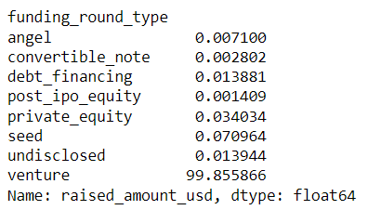
Major Challenge
Q1:Determine what percentage of the total funding was raised through each round type
Total of values for each column divided by total observations in raised_amount_usd and multiplying the whole with 100 gives the total funding percentages of each column.
Code :
Output:

Slide 28
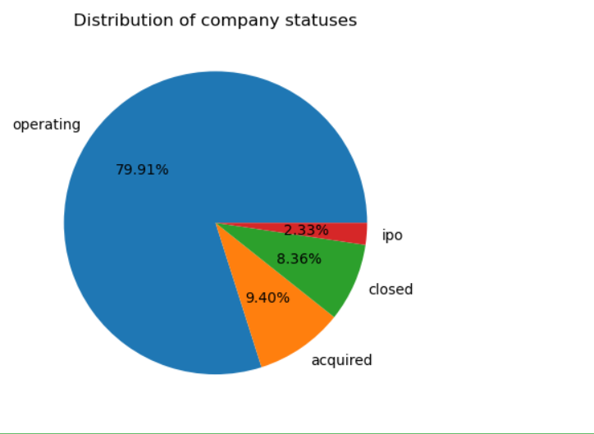
Major Challenge
Q2:Visualize the distribution of company statuses (e.g., operating, closed) using a pie chart or bar plot.
Code :
Output:
Operating companies are higher than companies with other statuses. Ipo status is the lowest in the distribution

Slide 29
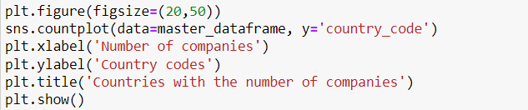
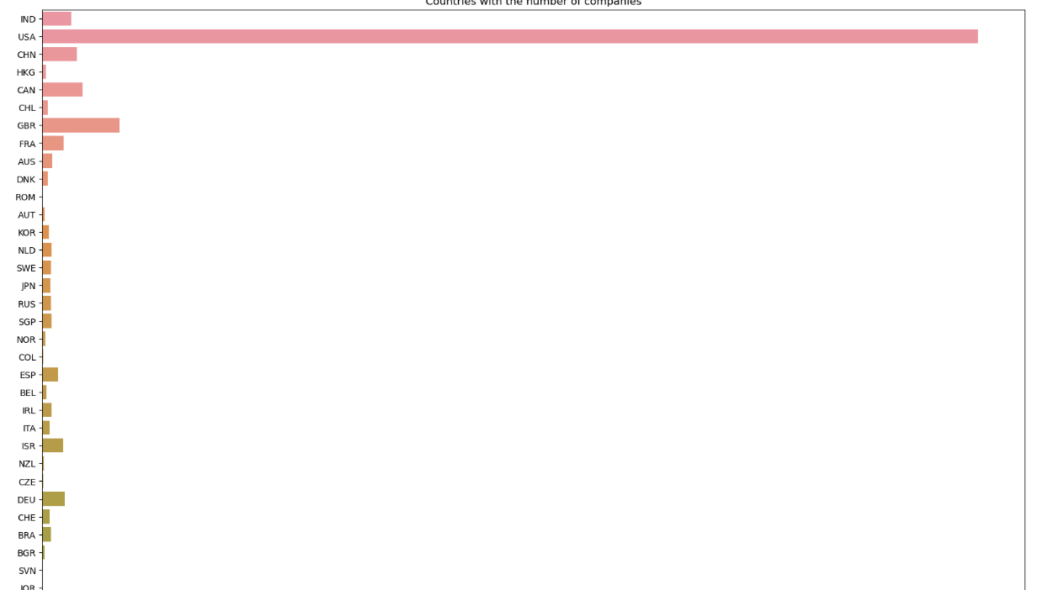
Major Challenge
Q3:Visualize the countries with more number of companies in the master_dataframe
Code:
Output:
USA has the highest number of companies followed by GBR, CAN, CHN and IND. Countries with lowest number (1) of companies are KNA, BRN, DZA, TGO, and GGY.

Slide 30
Major Challenge
Q4: Which country has the highest growth rate for the last decade
Data of year 2005 and 2015 were retrieved. Raised_amount_usd were summed for each country for year 2005 and 2015. Growth rate is then calculated for all countries based on the formula:
Growth rate= ((amount raised in 2015/amount raised in 2005)^(1/10)) x 100
Code:

Slide 31
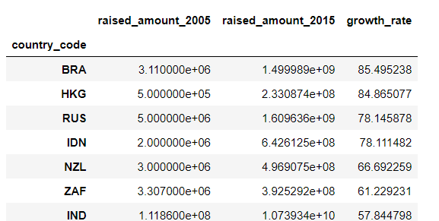
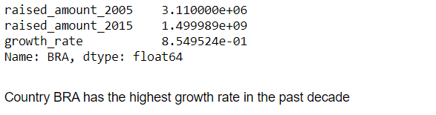
Major Challenge
Q4: Which country has the highest growth rate for the last decade
Code:
Output:

Slide 32
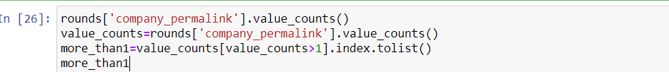
Major Challenge
Q5: Find the companies that have been to more funding rounds and arrange them based on the companies, dates, and round code.
Companies with more than 1 value counts are filtered. Funded_at is converted to a proper date format. Then, the companies were sorted based on the company permalink, date, and funding round code.
Code:

Slide 33
Major Challenge
Q5: Find the companies that have been to more funding rounds and arrange them based on the companies, dates, and round code.
Output:

Slide 34
Conclusions
We learned and practiced visualization techniques such as barplot and pie chart.We were able to examine the performances and get the data from the asset management datasets by applying npv codes such as crosstab,sortvalue, and pivot tables.analyze company trends and learn about investment strategies
More techniques, such as null value analysis and treatments can be used in asset management data sets.
We got to apply pivot tables to perform country-wise and funding round type-wise analyses and use visualization techniques on the data.
We also learned about investing in companies based on the countries that received most of the investments and how growth rate also plays an important role in investing when we focus on the funded years.

Slide 35
Thank You !!!....

